Slide 1
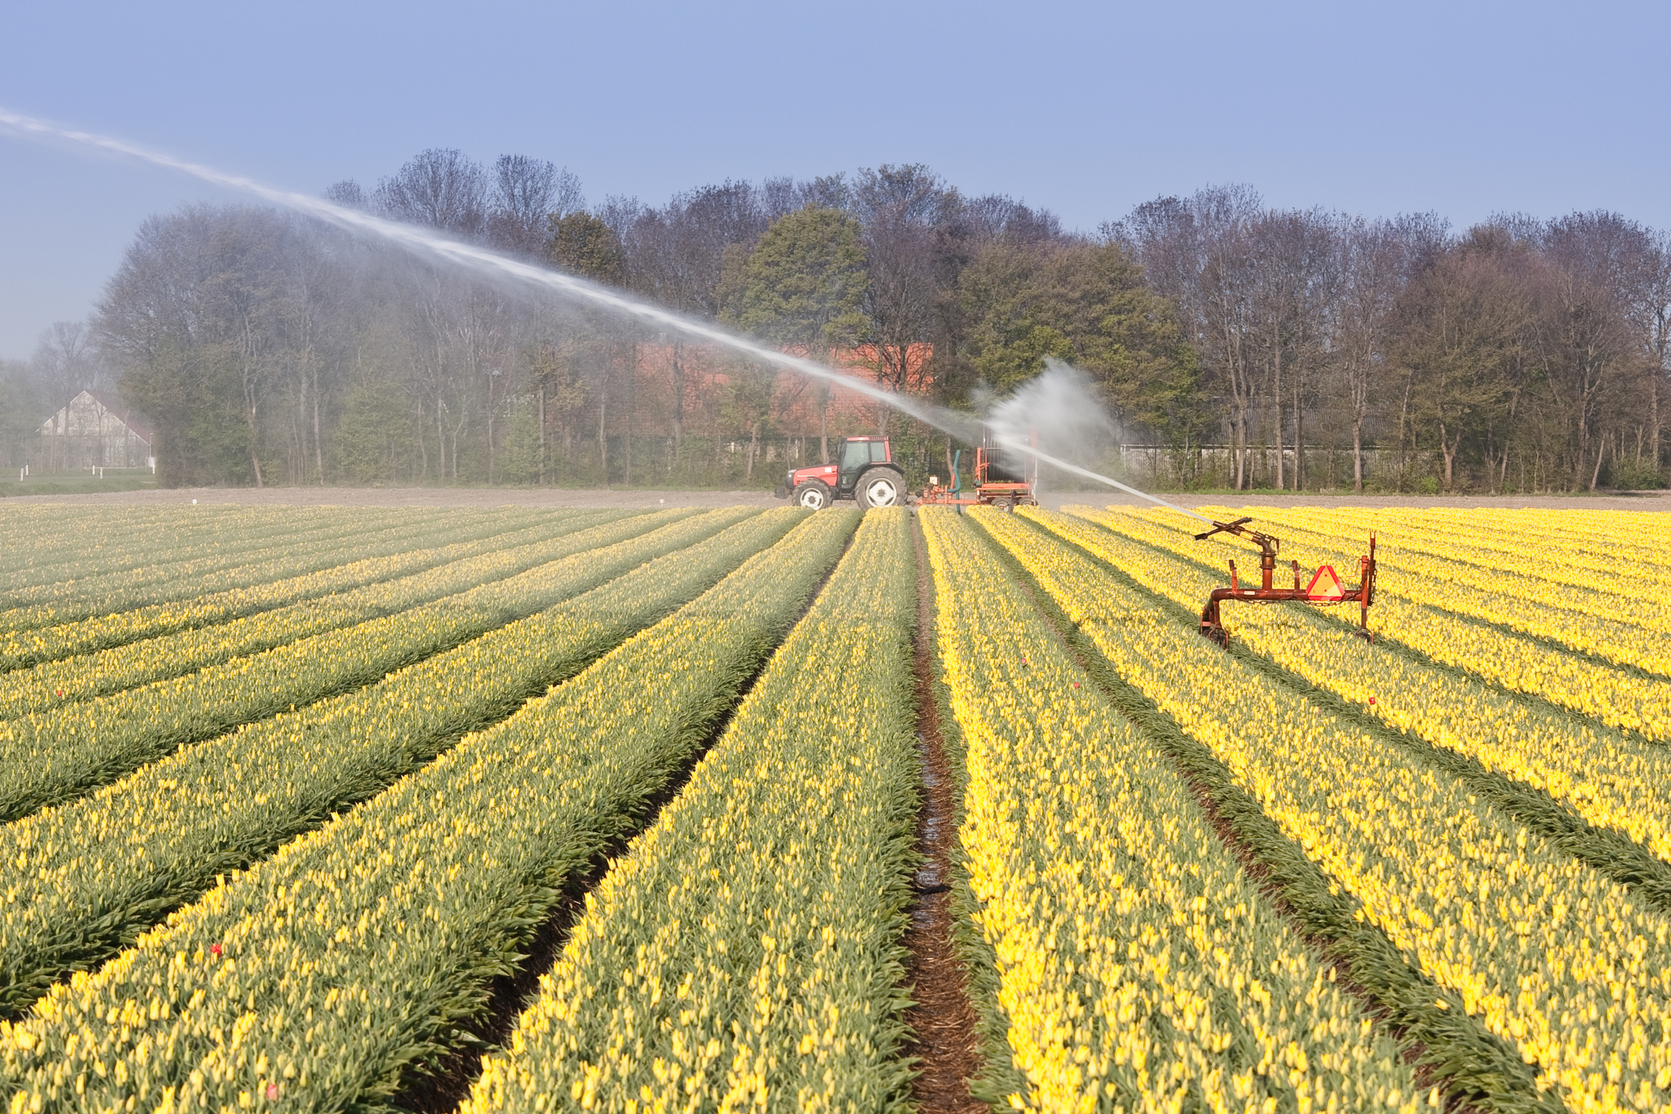
Improving the modelling of ammonia by detailing emission information
Carlijn Hendriks, Sander Jonkers, Richard Kranenburg, Martijn Schaap

Slide 2
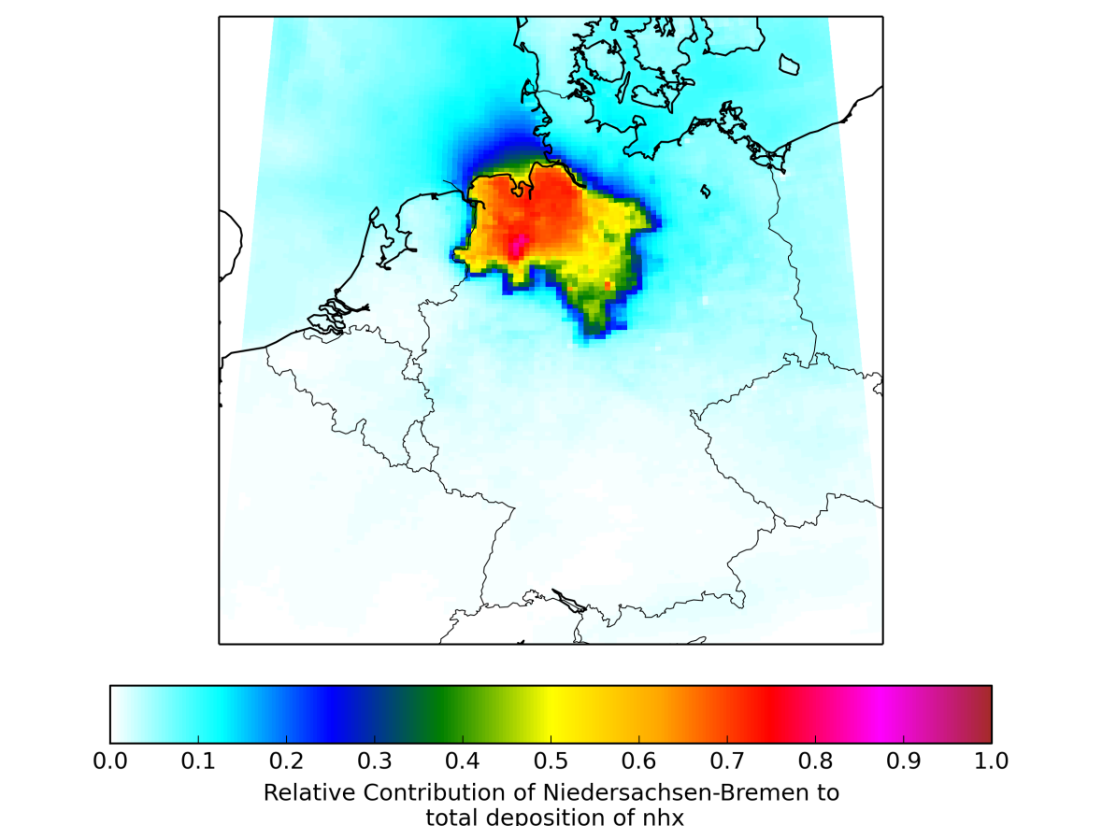
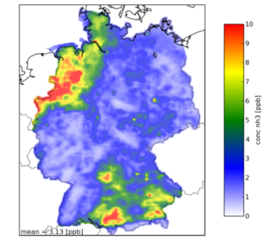
Reactive nitrogen
Nitrogen deposition causes biodiversity loss
Ammonia and nitrogen oxides are important precursor gases for aerosols
Improving the ammonia budget requires
    To appropriately detail spatial and temporal emission distributions
    Detailing the exchange processes
    To include the atmospheric loss and production via SIA correctly (trends)
Goal: To inform on a few developments for ammonia modelling
Contribution of Lower Saxony to NHx deposition

Slide 3
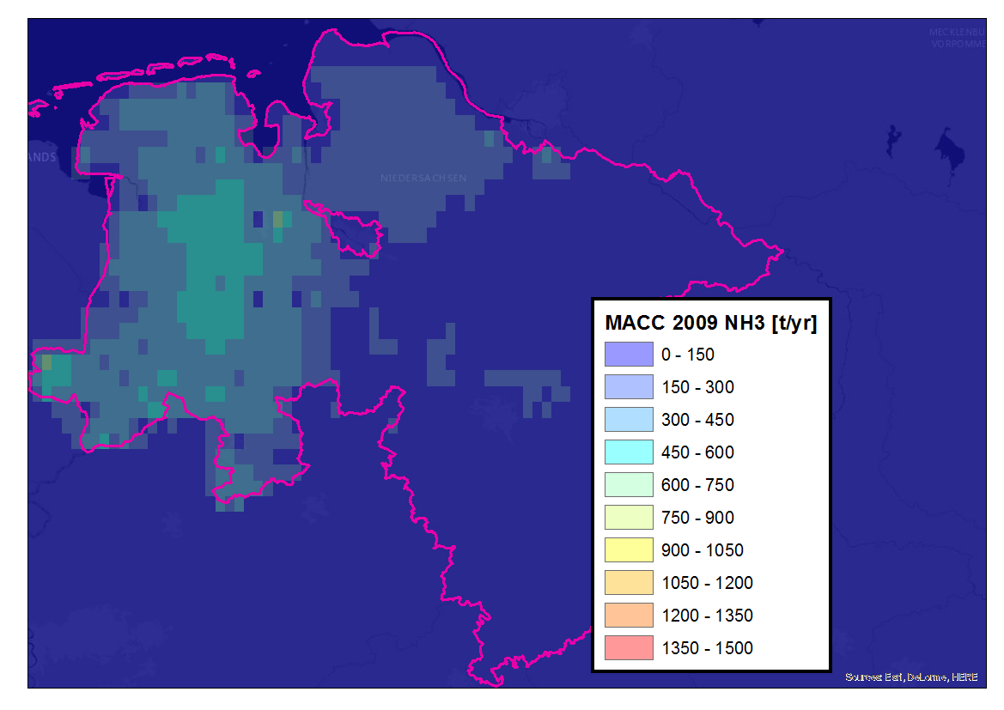
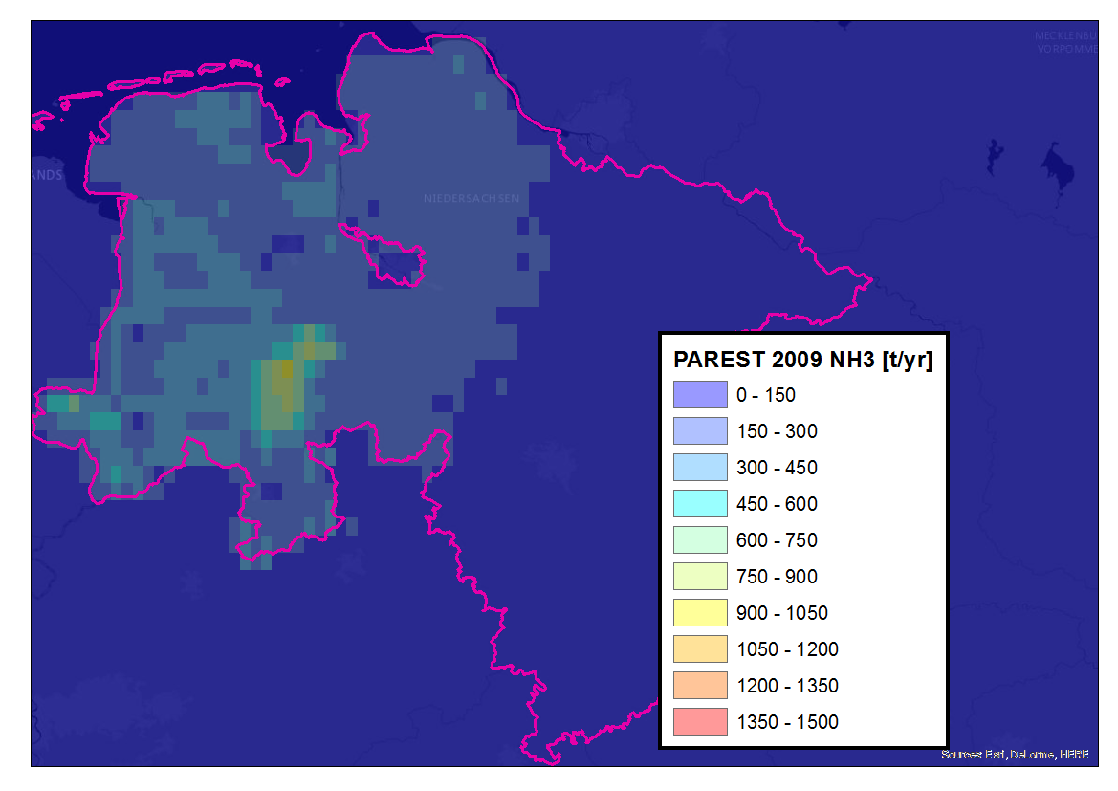
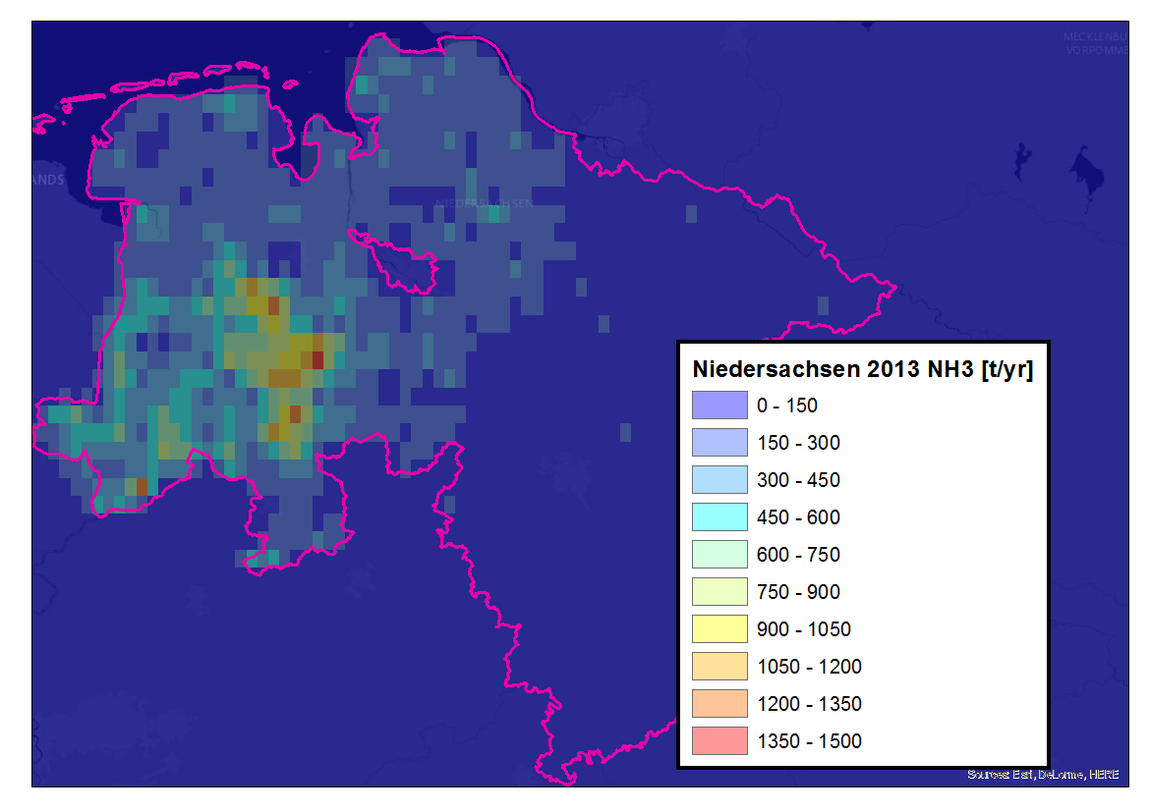
Comparison of European, national and Regional emission distributions
TNO-MACC
PAREST
Local inventory
PAREST
Local inventory based on an update of ammonia emission distribution based on estimated livestock housing surface area as derived by GAA-Hildesheim
Regional knowledge on emissions crucial for the increased resolution in EMEP
New local

Slide 4
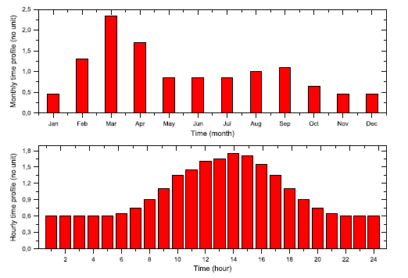
Standard static time profiles
Standard profiles applied everywhere, irrespective of agricultural practice and meteorological conditions. Introducing these dependencies may lead to significant changes in regional nitrogen budgets.

Slide 5
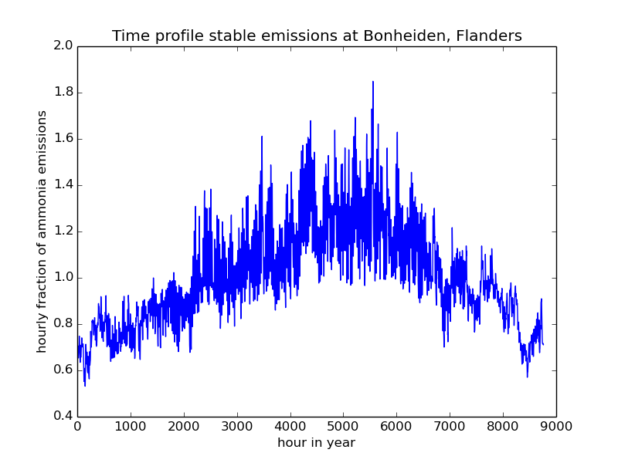
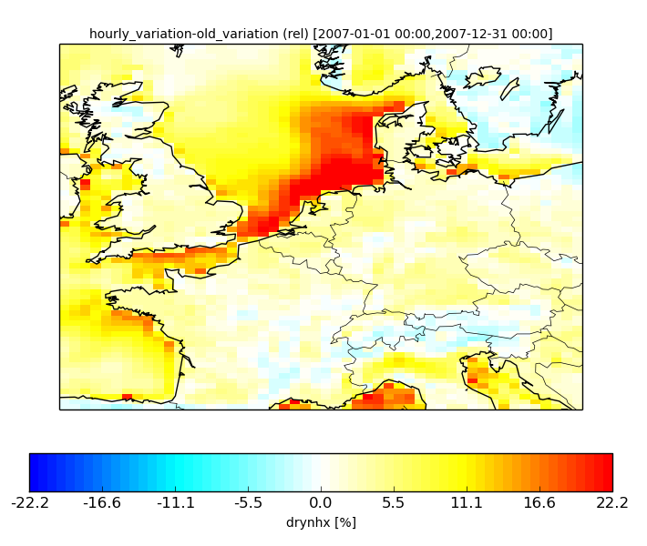
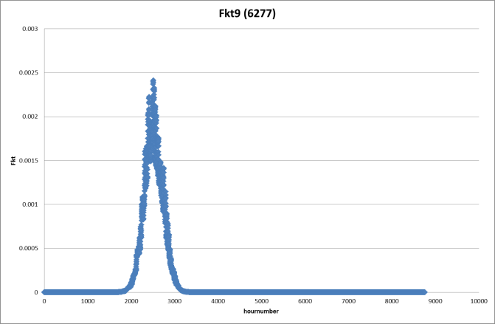
Impact of implementing Skjoth et al. (2011)
Livestock housing
Relative change in NHx dry deposition
Late spring manure application

Slide 6
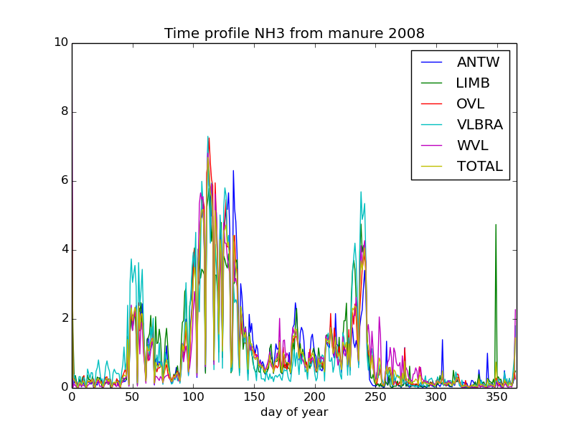
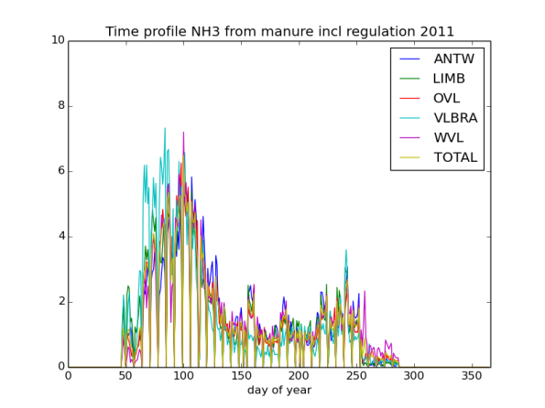
Using manure transport data as a proxy for application emissions
Manure transport data from farmer to farmer obtained from Vlaamse Landmaatschappij for 2007-2013

Slide 7
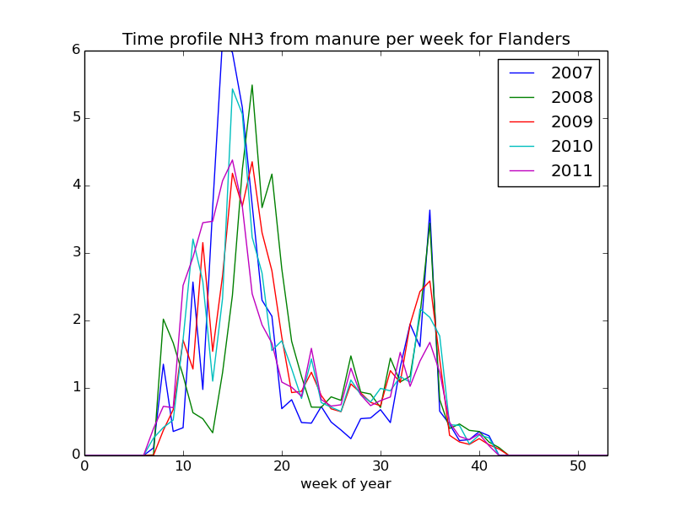
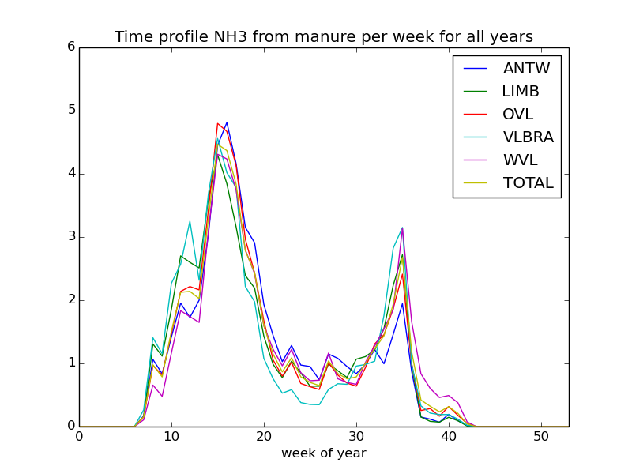
Variability between years larger than between regions

Slide 8
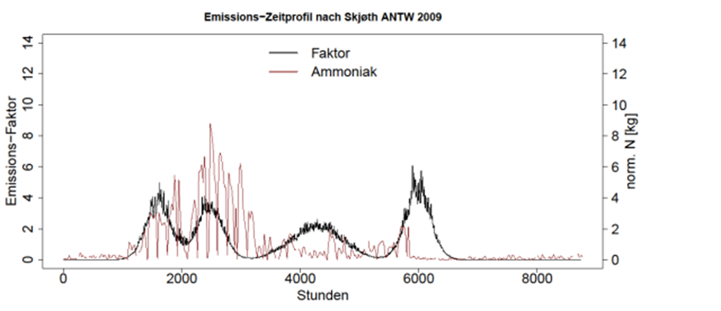
Comparison against Skjoth et aL. (2011)
Antwerpen, 2009
Original Skjoth modes
Adjusted parameters for the normal distributions from Skjoth et al (2011) for Flanders
i | µ_{i} [d] | σ_{i} | W_{mi} | Description
1 | Tsum₁₁₀ | 9 | 0,39 | Spring application to bare soil
2 | Tsum₃₆₂ | 9 | 0,39 | Spring application to vegetated soil
3 | Tsum₁₄₀₀ | 32 | 0,11 | Summer application
4 | 227 | 9 | 0,11 | Fall application

Slide 9
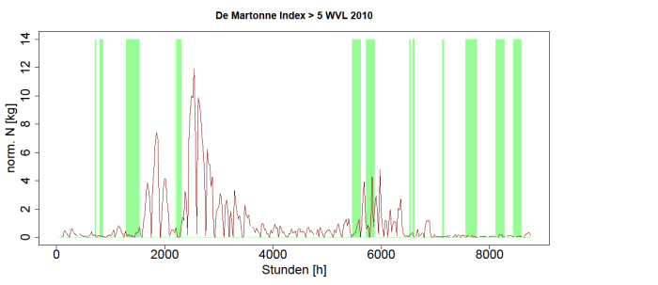
Introduction of regulation and other parameters
No manure application:
During winter (15 okt - 15 feb) and on sundays.
During coniditions of frozen or snow covered soil
During vegetation calm
During conditions with very wet soil conditions that make application in-effective and prohibit access to the fields (De Martonne-index > 5)

Slide 10
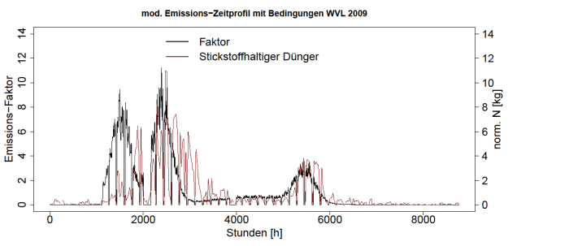
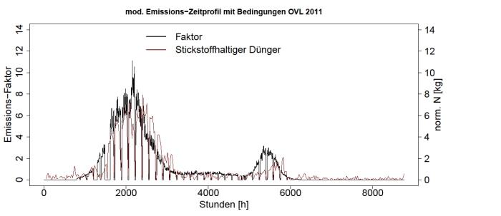
Resulting parameterization
West-Vlaanderen, 2009, R = 0.57
Oost-Vlaanderen, 2011, R = 0.87

Slide 11
Application to Flanders
Spatial allocation:
  Flanders & the Netherlands using national inventories
  TNO-MACC-II for all other regions
Timing of manure spreading based on manure transport data: We assume
  No storage and emission to occur at day of transport
  Ammonia emissions scales with N-content,
  The same technologies used throughout spreading seasons and region
  LOTOS-EUROS does not include a module for explicit evaporation from soil (yet) so we assume standard diurnal cycle for these emissions
Livestock and fertilizer emissions following Skjoth et al (2011)

Slide 12
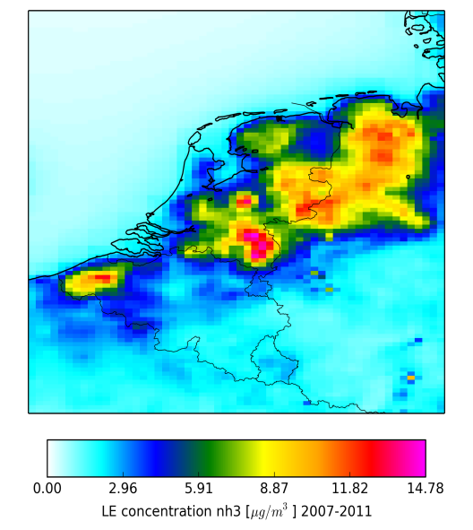
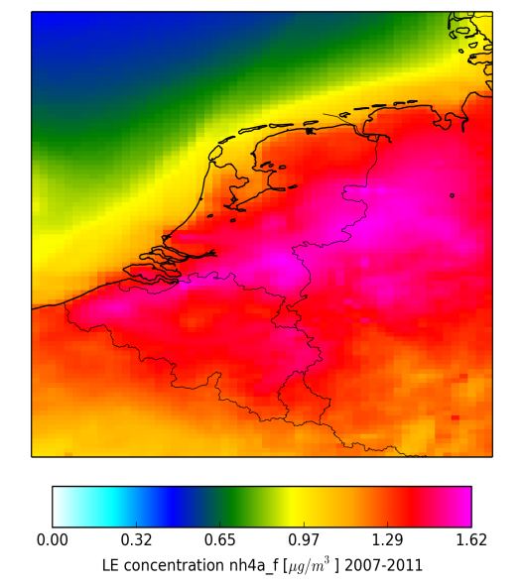
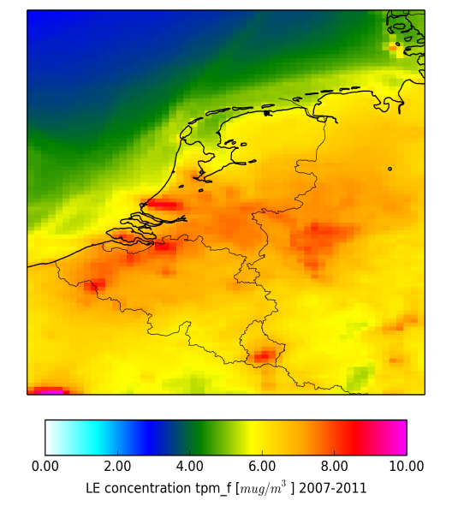
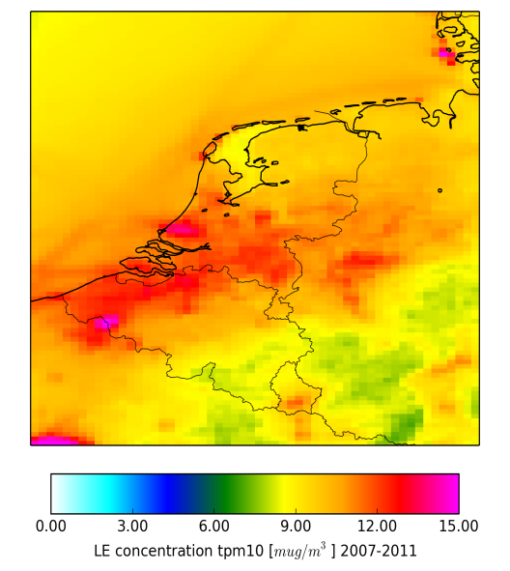
Modelled distributions
NH₃
NH₄
PM_{2.5}
PM₁₀
Inclusion of adopted ammonia time profiles did hardly impact the modelled ammonia annual mean levels in Flanders

Slide 13
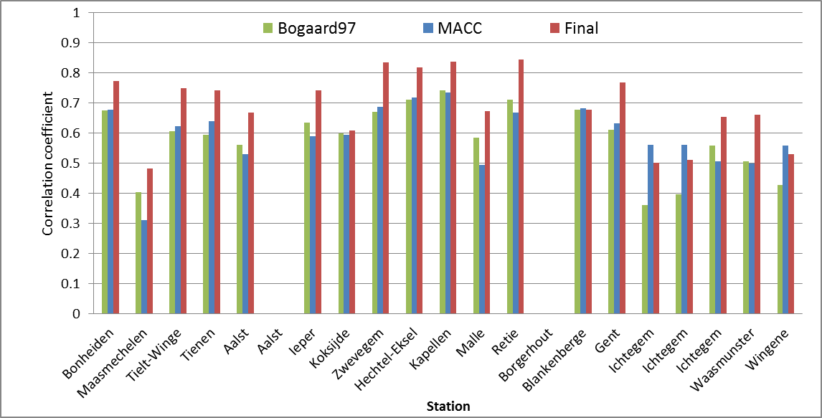
Correlation for time series of two-weekly data for 2007-2011

Slide 14
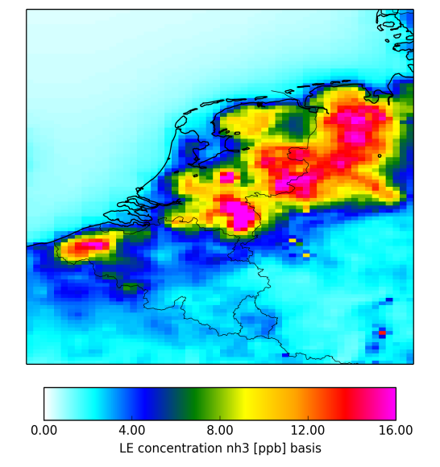
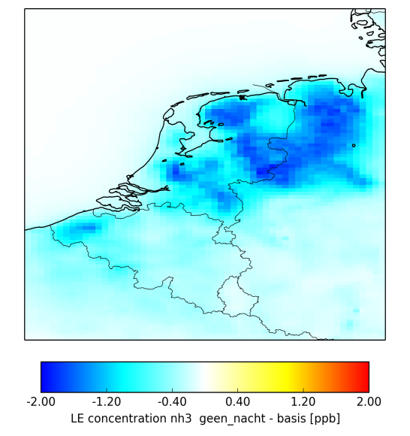
Sensitivity simulation
Difference due no night time emissions

Slide 15
Inter-annual Variation:
2011 and 2012 contained warm springs
Average over 17 Stations in Lower Saxony
Source:
Andreas Hainsch
Highlights the need for explicit modelling of the emission from a fertilized field and going away the practice to keep emission totals as reported.

Slide 16
Conclusions and Outlook
Although we only made a first step, this work shows that detailing the ammonia emission information in space and time beyond the current state of the art has a high potential to increase the model performance significantly
We developed a new parameterization for the timing of manure application in Flanders. It’s use for other areas needs to be evaluated.
Outlook:
Further detailing the agricultural activities and their timing
Include a parameterization for modelling the ammonia evaporation from fertilized soils
Expand the database for the evaluation of ammonia to the period 2000-2014
Apply remote sensing data for evaluation purposes
Investigate impacts of variable ammonia emissions on trends

Slide 17
Thank you for your attention

Slide 18
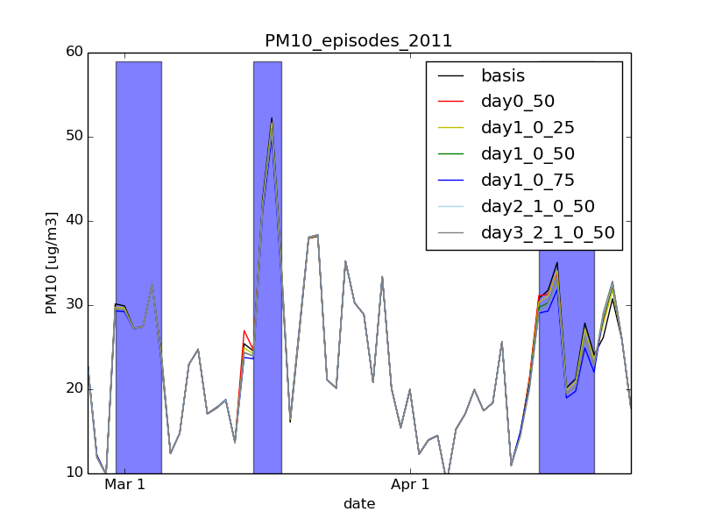
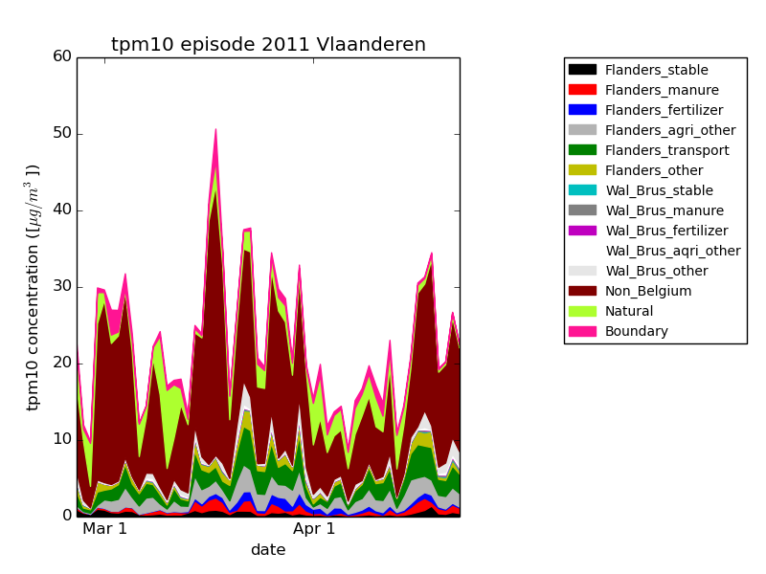
Does a limitation to manure application during a PM episode reduce peak values?
Impact on PM₁₀ is limited (maximum was 3 µg/m³)
Contribution of Flemish manure application to PM is relatively small (max 4 µg/m³)
Flanders is relatively small area
Ammonia is re-emitted through compensation point
Excess NH₃ available in Flanders

Slide 19
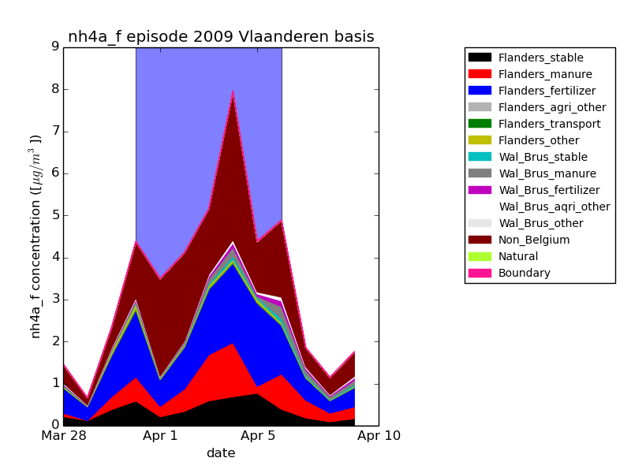

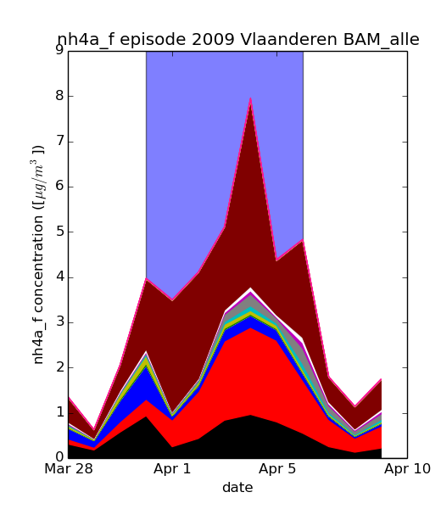
Resultaten gevoeligheidsrun voor episodes
Andere verdelingen landbouwemissies weinig invloed op totale concentratie NH₄ en PM
Brontoekenning episode verandert wel!
Bijdrage van stallen aan NH₄ wordt ook anders, hoewel aan die verdeling niets veranderd is → opvuleffect door overmaat NH₃

